Slide 1
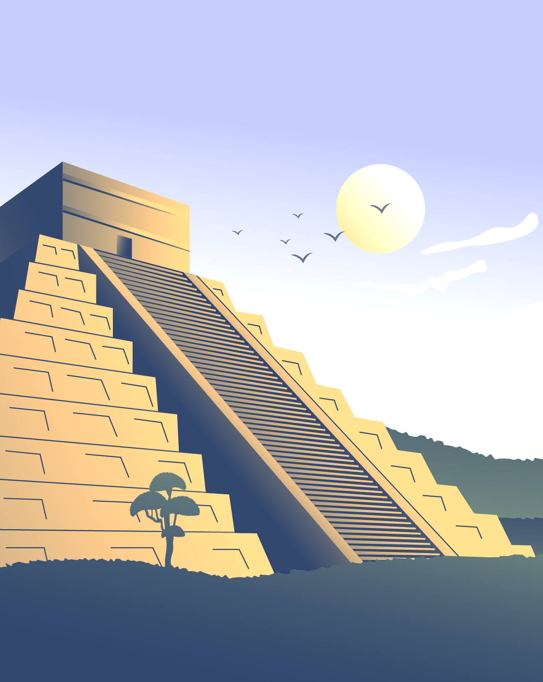
Bad Request
History and Geography
Project

Slide 2
Process
Idea
Realization
01
02
Idea and explanation
Ways of realization
Apps used
Our Team
03
04
What we used.
Who did what

Slide 3
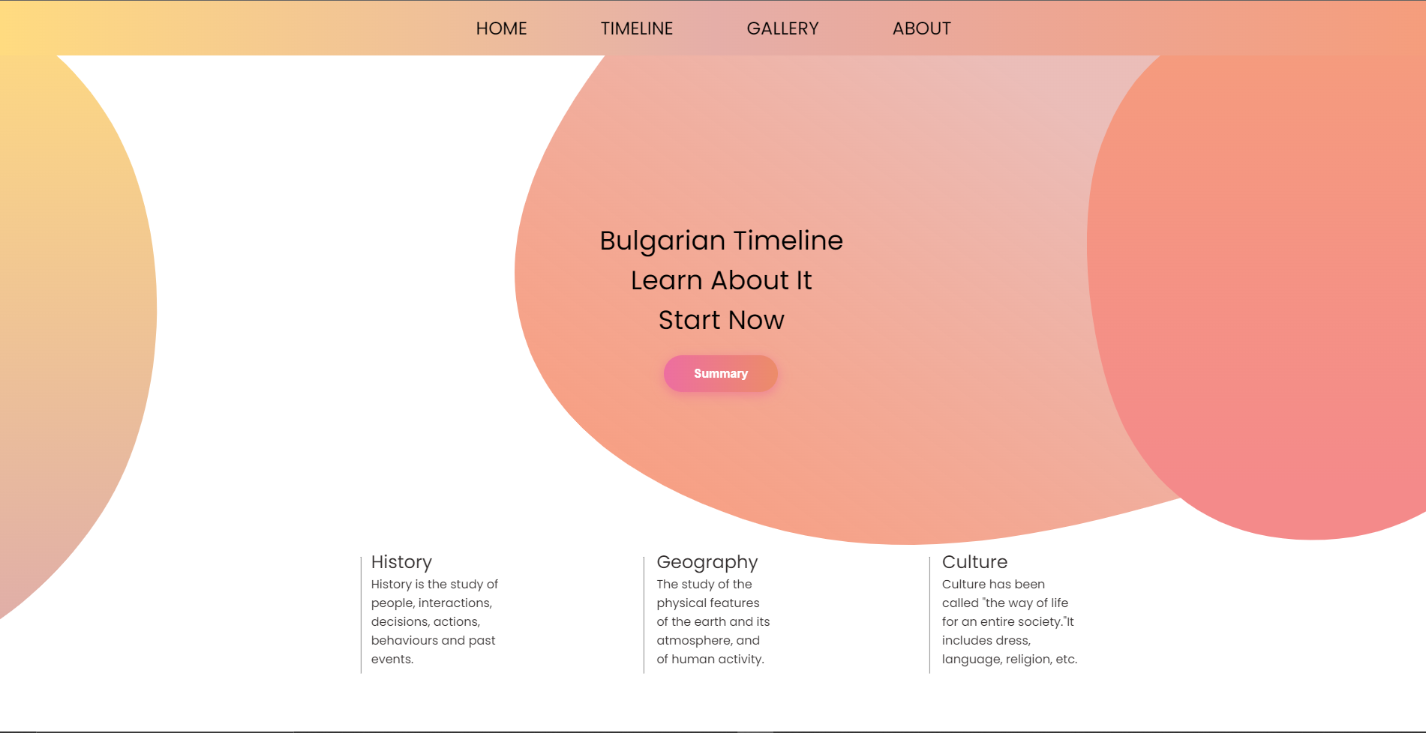
Idea
Our idea was to present the Bulgarian history with maps in a easy to understand and user-friendly way.
The website we created is made to be compatible with all devices for user comfort.

Slide 4
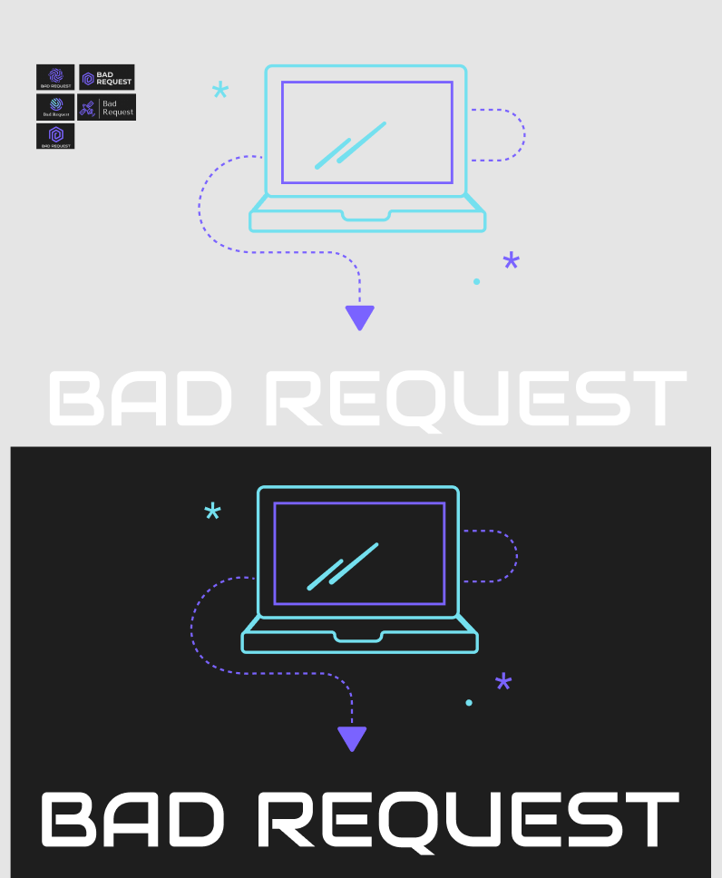
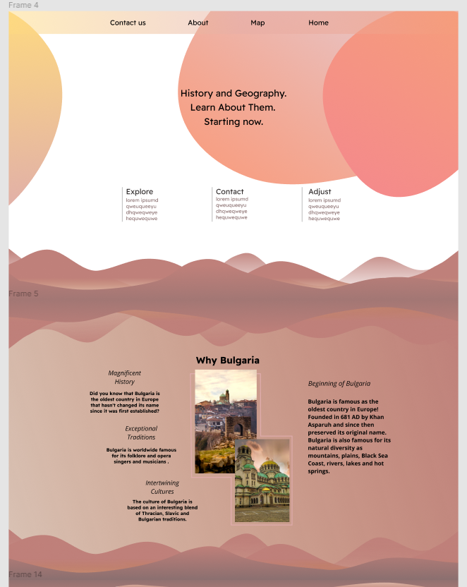
Realization
We realized our project through collaborative work across different online platforms and coding environments.
Every day we had meetings to discuss progress and responsibilities of the respective team members.

Slide 5



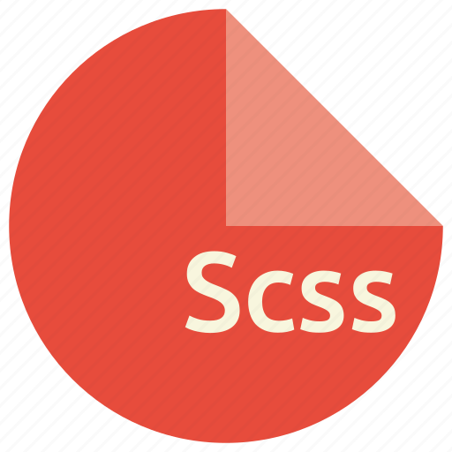





Technologies used in the project

Slide 6
Our Team
Designer
Hristiyan Petrov
Scrum Trainer
Stefan Hristov
Back End Developer
Maksim Marinov
Front End Developer
Petar Matsaliev

Slide 7
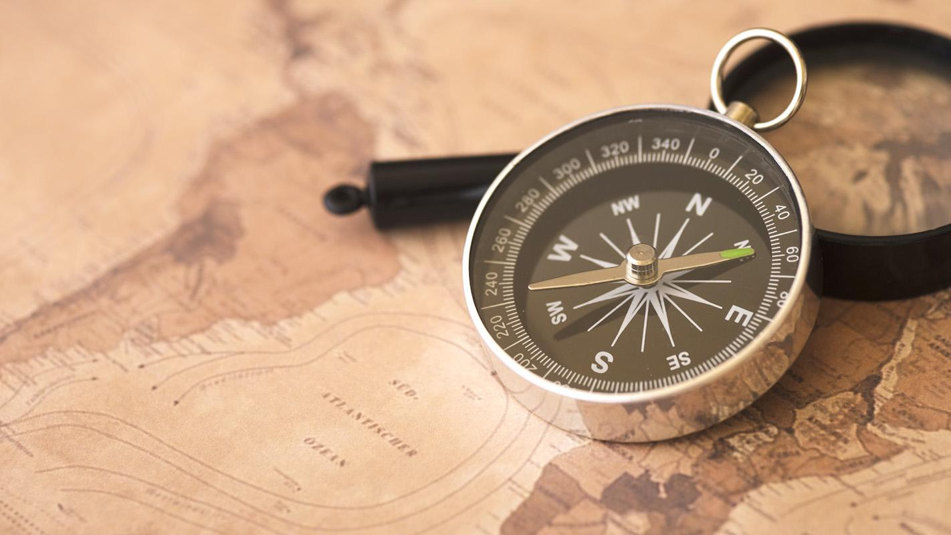

Let’s move on to the site!

